Slide 1
Phylomorphospace:
Application of 3D Morphometrics to Phylogenetics
Houstoun April 3, 2024

Slide 2
Overview
1
2
3
4
Intro to Phylomorphospace
What are the pros and cons?
Paper 1
Ecological origins of snakes as revealed by skull evolution
Landmarking Theory
What are landmarks and how do we use them?
Paper 2
Shape and size variation in elapid snake fangs and the effects of phylogeny and diet

Slide 3
Phylomorphospace
Projecting phylogenies onto two-dimensional morphospaces has been done since the 1980’s
Rohlf (2002) demonstrated that geometric morphometric variables can be fit to a phylogeny
One approach to phylogenetic ordination
Projects a phylogeny into the PCA space using ancestral states
Notes:
Morphospace: the space spanned by the set of morphological variables used to describe and compare the taxa studied
Phylomorphospace: the projection of a phylogeny into a multivariate morphospace to map the history of a clade’s morphological diversification and infer the magnitude and direct of shape change along any branch of the phylogeny
Bookstein et al. 1985
Previously used to investigate the correlation between shifts in morphology, habitat, diet. Additionally the order of morphological transformations, convergence, partitioning, and to visualize adaptive radiations.
Phylogenetic ordination: provides visual insights into macroevolutionary patterns
Other types include Phylogenetic PCA and Phylogenetically-Aligned Components Analysis

Slide 4
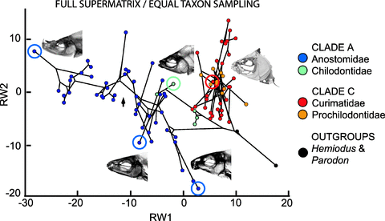
Phylomorphospace
R package called ‘phytools’
Utilizes placed landmarks and a phylogeny to create a phylomorphospace plot for your data
Sidlauskas (2008)

Slide 5
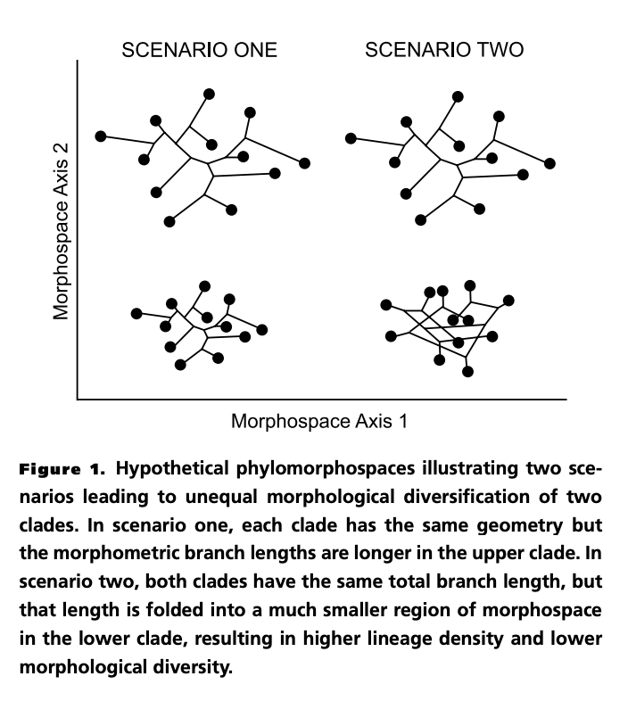
Phylomorphospace
Magnitude: Unequal magnitude of change per phylogenetic branch
Predicts that the mean Euclidean distance between adjacent nodes in the phylogeny will be higher in one clade than in the other.
Mode: Unequal efficiency in morphological innovation
Predicts that the branches of the phylogeny will be packed much more densely in morphospace in the clade with low morphological diversity than in the clade with high morphological diversity.
Sidlauskas (2008)
Sidlauskas (2008)
Notes:
Magnitude: Lineages with in the clade with high morphological diversity experiences more morphological change per phylogenetic branch on average than did lineages in the clade with low morphological diversity
Mode: Neither clade experienced more morphological change per phylogenetic branch, but the clade with high morphological diversity explored more novel regions of morphospace

Slide 6
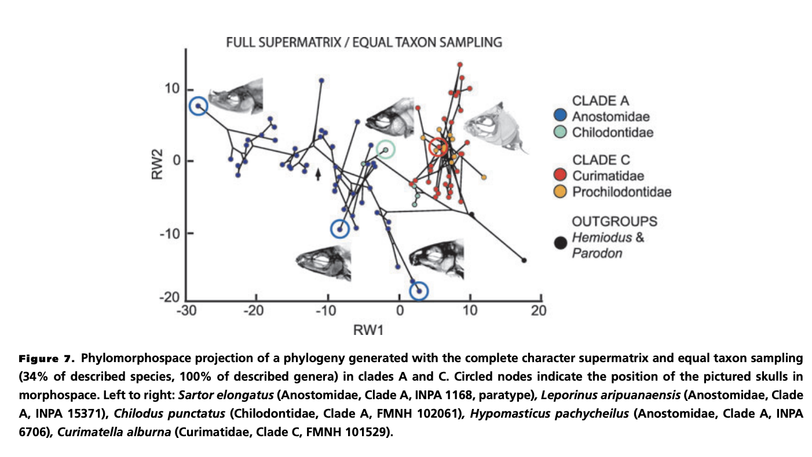
Sidlauskas (2008)
Notes:
Circles are the pictured skulls.
A: Morphologically diverse clade: distributed an equal amount of change more widely through morphospace and innovated continually
C: Morphologically less diverse clade: substantial morphological evolution but most of the clades expansion in morphospace occurred in the most basal branches. More derived portions of the radiation oscillated within previously explored limits.

Slide 7
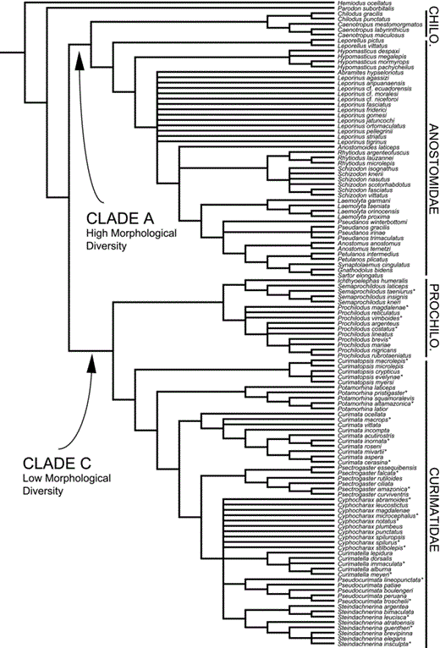

Slide 8
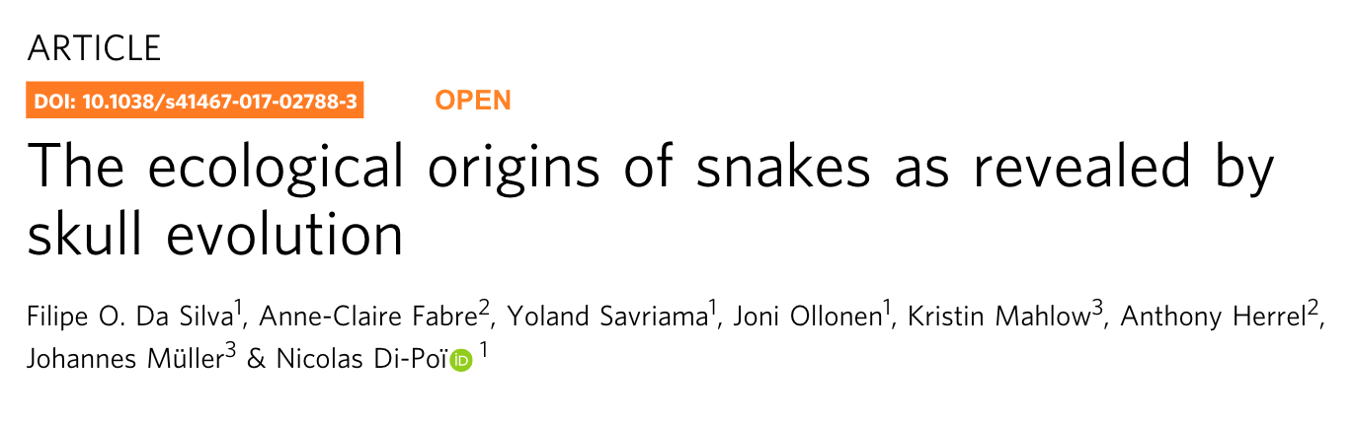

Slide 9
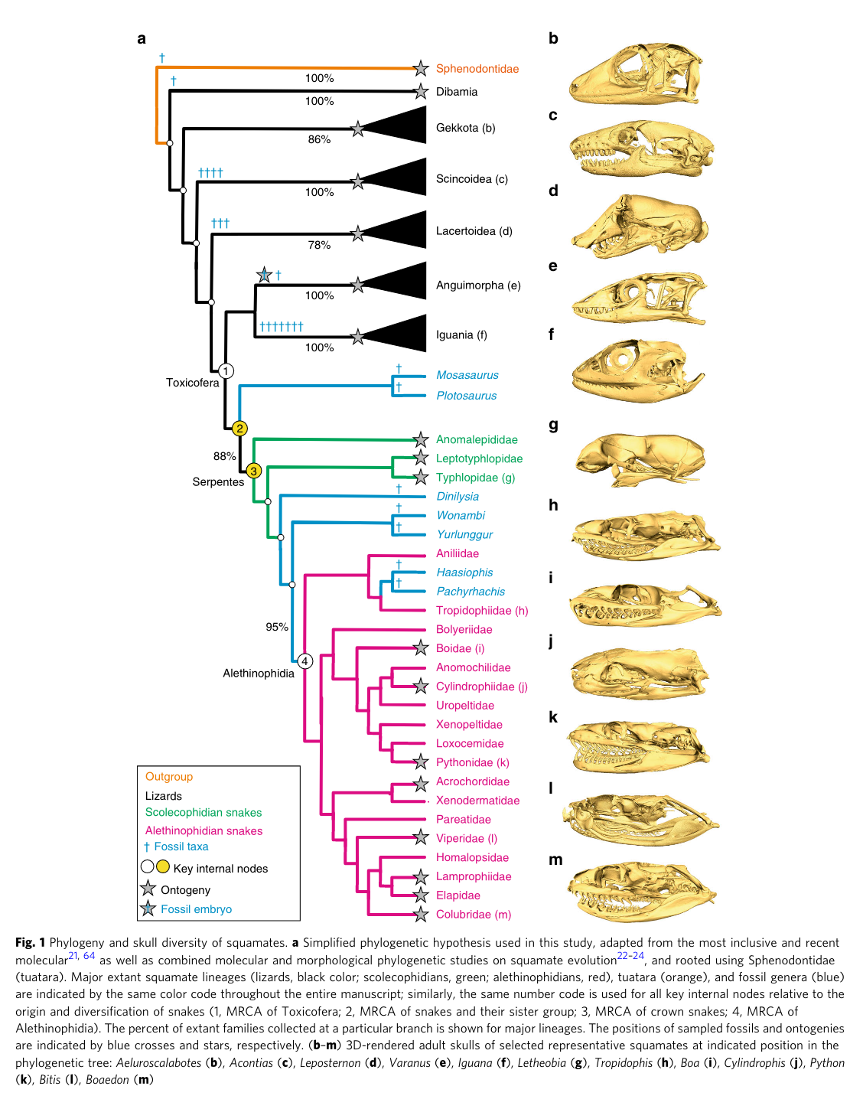

Slide 10
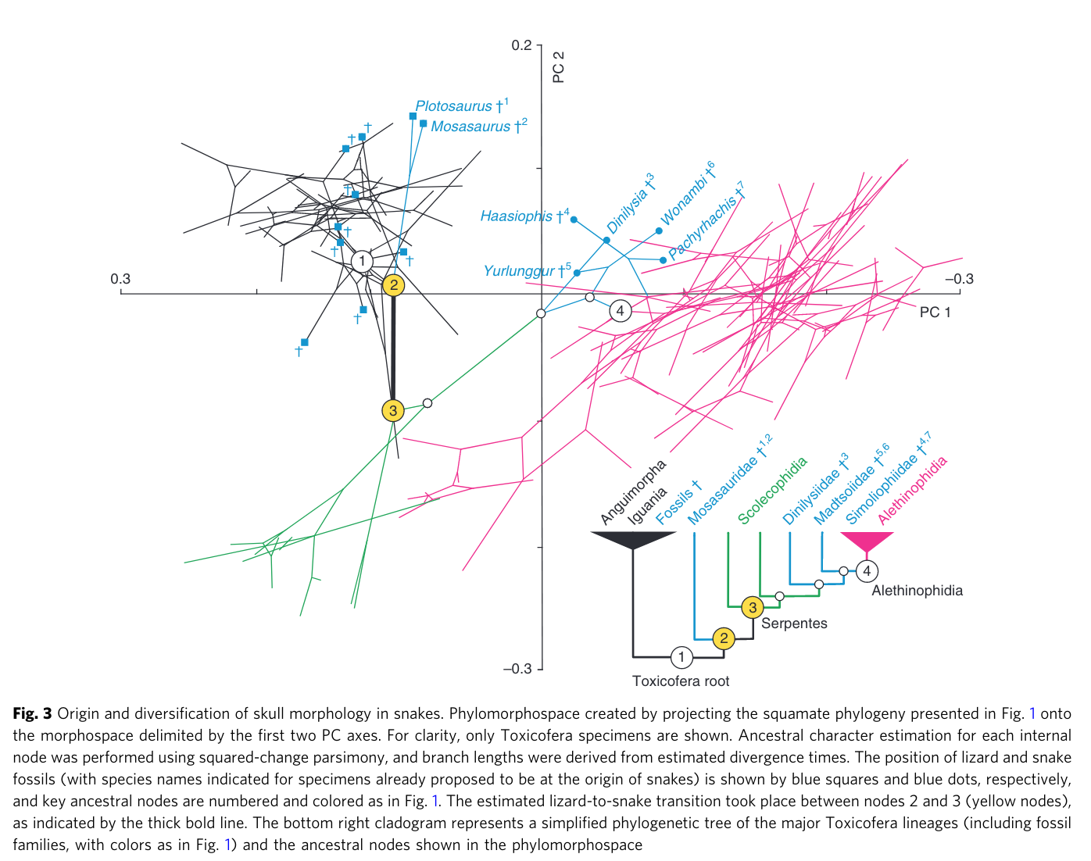
Da Silva et al. (2018)

Slide 11
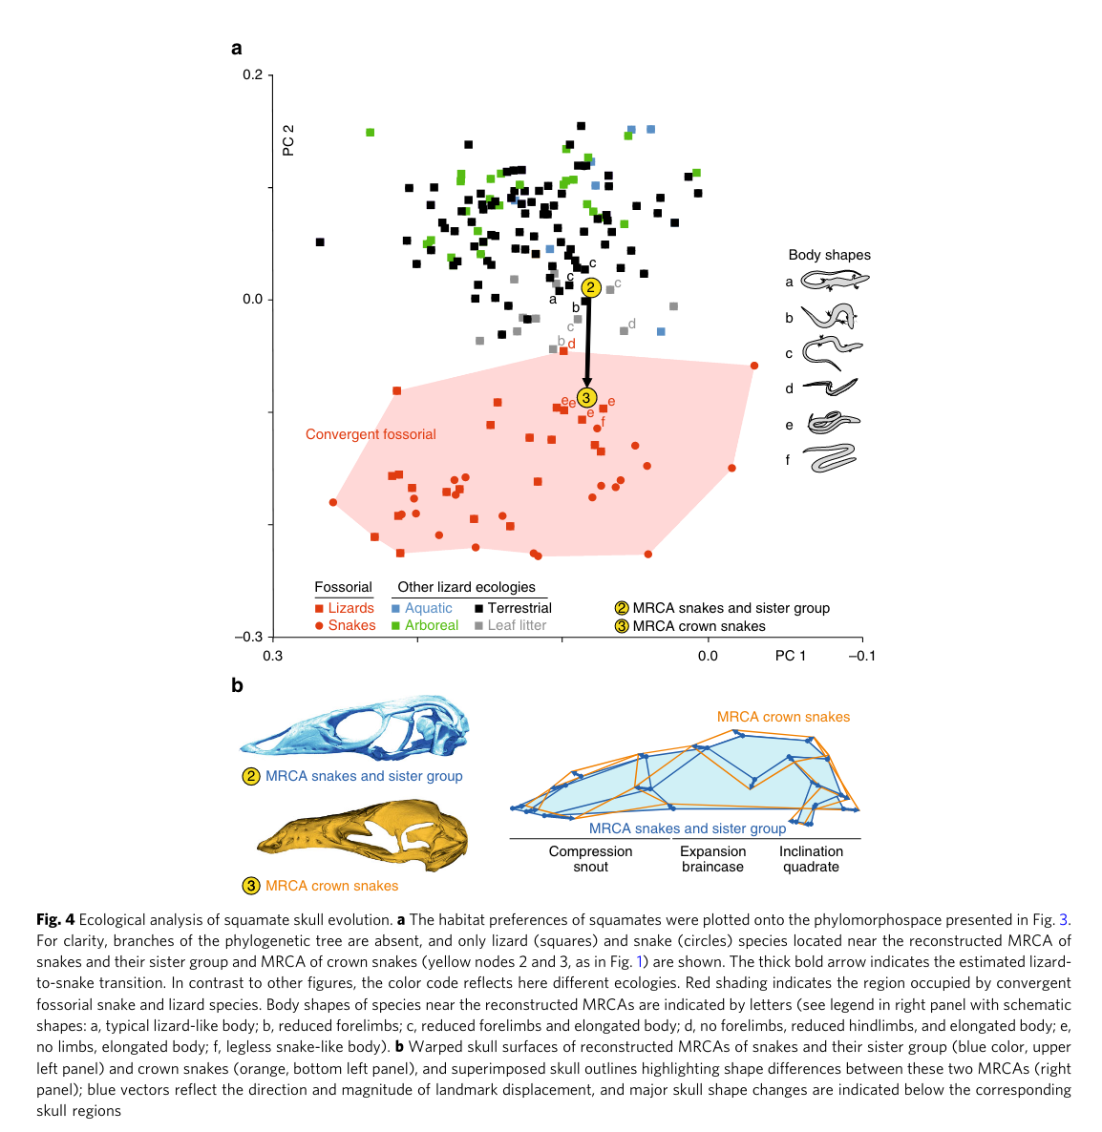
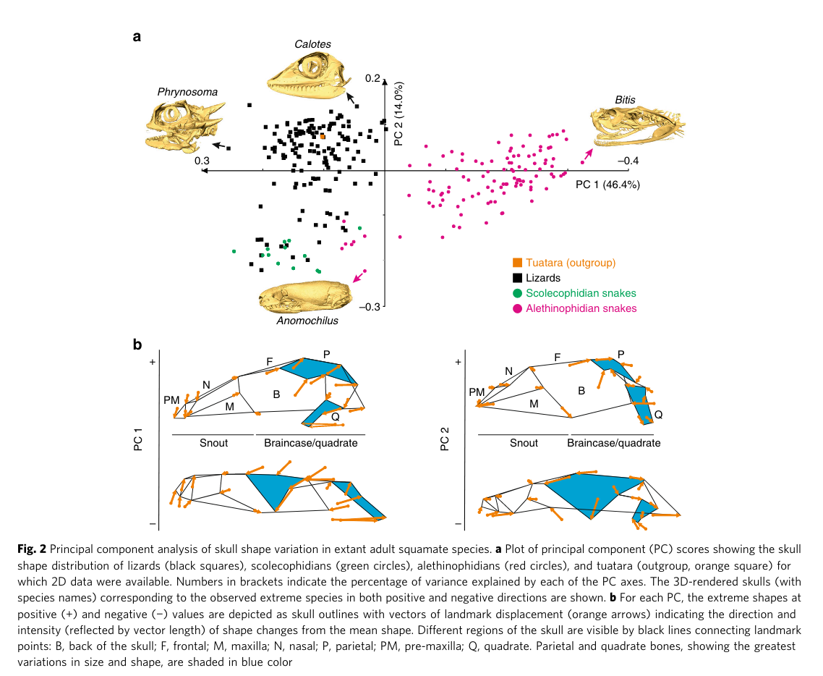
Da Silva et al. (2018)

Slide 12
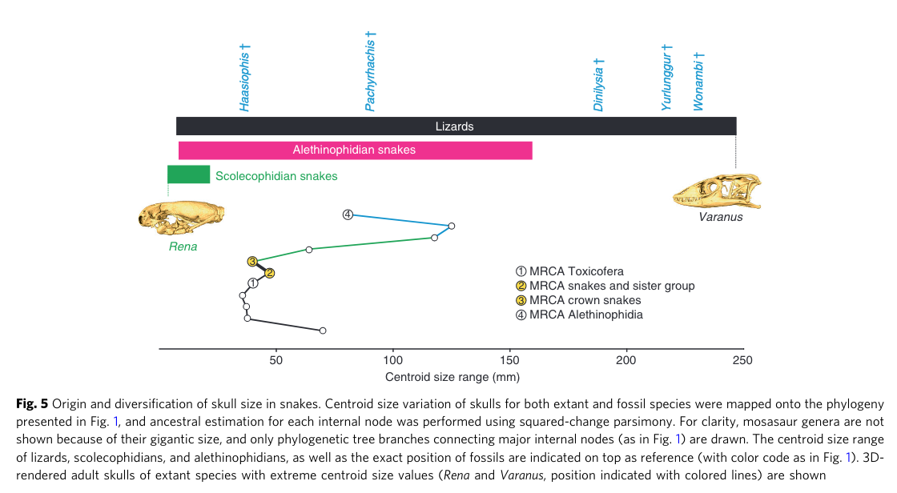
Da Silva et al. (2018)

Slide 13
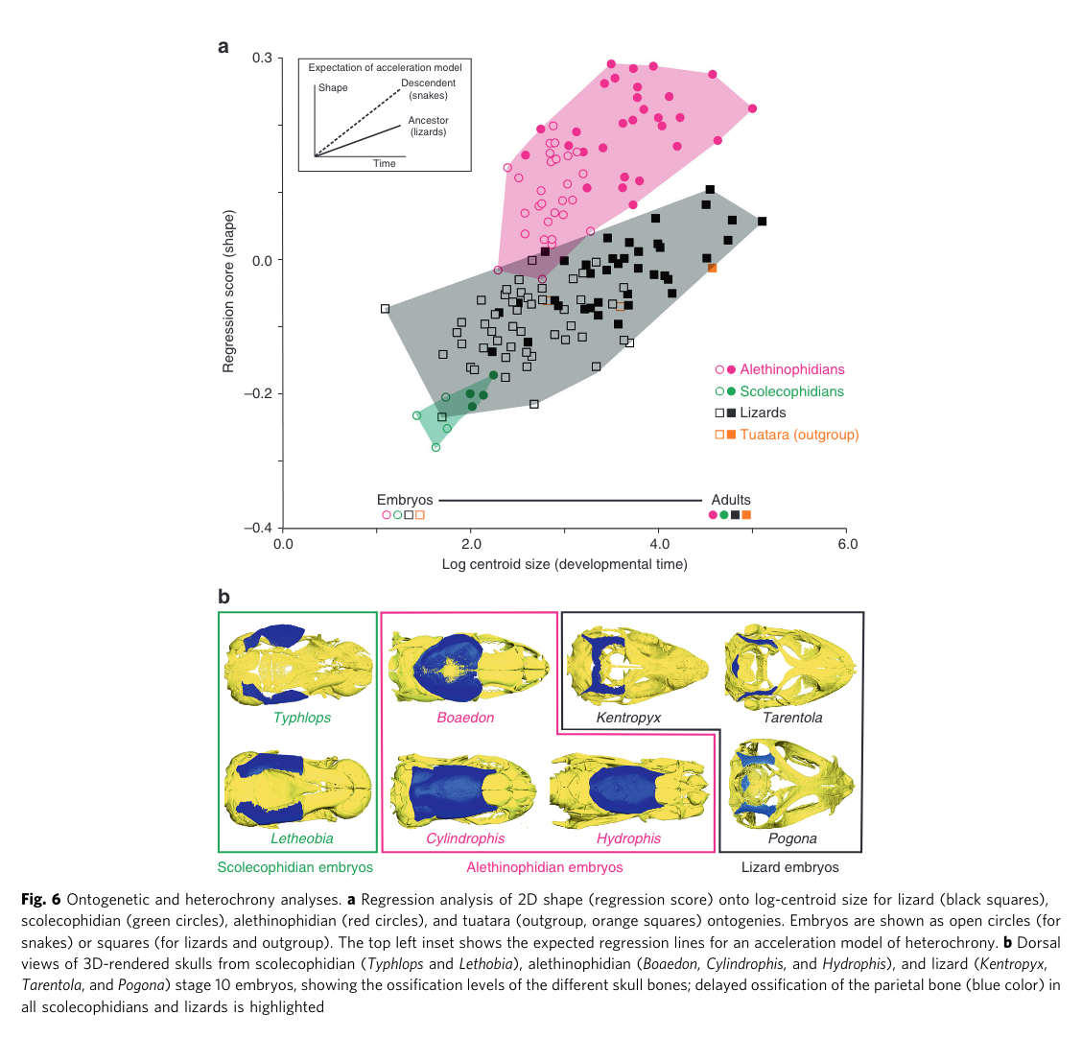
Da Silva et al. (2018)

Slide 14
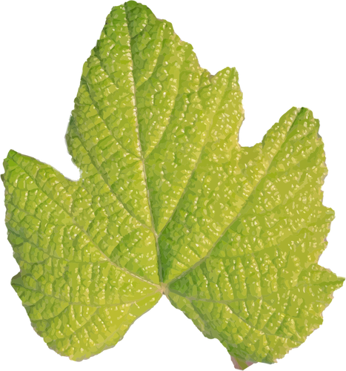
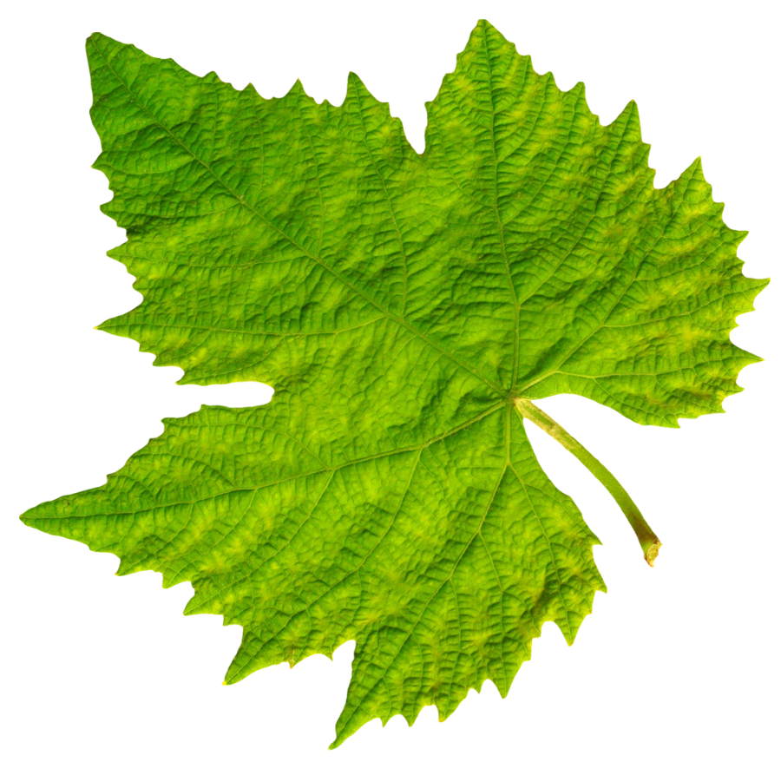
Landmarks:
Homologous Points
Discrete point or loci of correspondence or equivalency among organisms
Two approaches:
Homology
Landmark correspondence
s
Wärmländer et al. (2018)
Notes:
Landmarks are used to define and record distances, angles, curves, and coordinates for quantitive morphological comparisons within and between groups
The position must be reliable and repeatable
Homology: structures that have common evolutionary origins across specimens
Landmark correspondence: points based on anatomy, development, or function depending on the research question

Slide 15
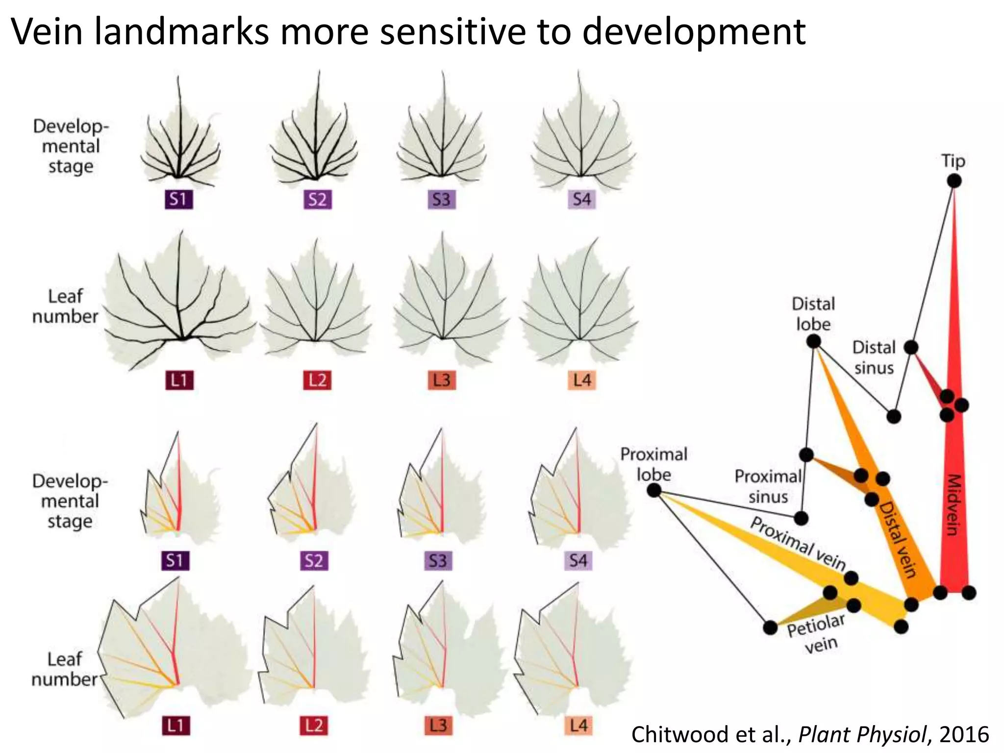
Landmarks:
Discrete point or loci of correspondence or equivalency among organisms
Two approaches:
Homology
Landmark correspondence
What about landmark type?
s
Wärmländer et al. (2018)
Notes:
Landmarks are used to define and record distances, angles, curves, and coordinates for quantitive morphological comparisons within and between groups
The position must be reliable and repeatable
Homology: structures that have common evolutionary origins across specimens
Landmark correspondence: points based on anatomy, development, or function depending on the research question

Slide 16
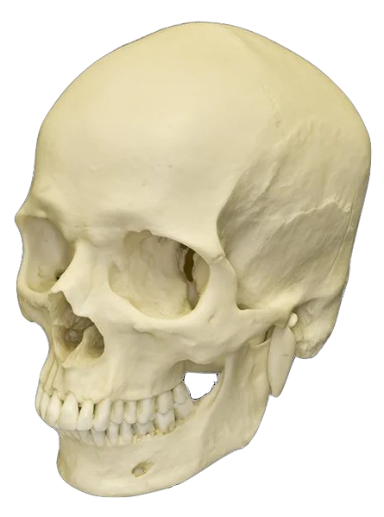
Landmarks:
Traditional Landmarks
Constructed Landmarks
Fuzzy Landmarks
s
Fuzzy
Ex// Constructed
Traditional
Valeri et al. (1998)
Notes:
Traditional landmarking derived from Bookstiens initial landmarking theory; classified as either a point where three structures meet or the maxima of a curvature
Constructed landmarks are mathematically defined or extremal points between landmarks. “Filling the gaps”
Fuzzy landmarks are those which lack a precise location and thus are recorded multiple times and averaged to determine a final location
Used to overcome human error in landmark placing across large structures wi

Slide 17
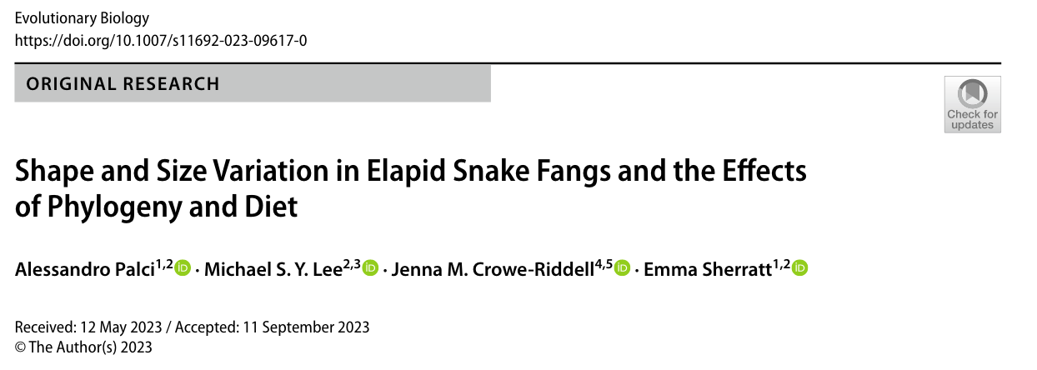

Slide 18
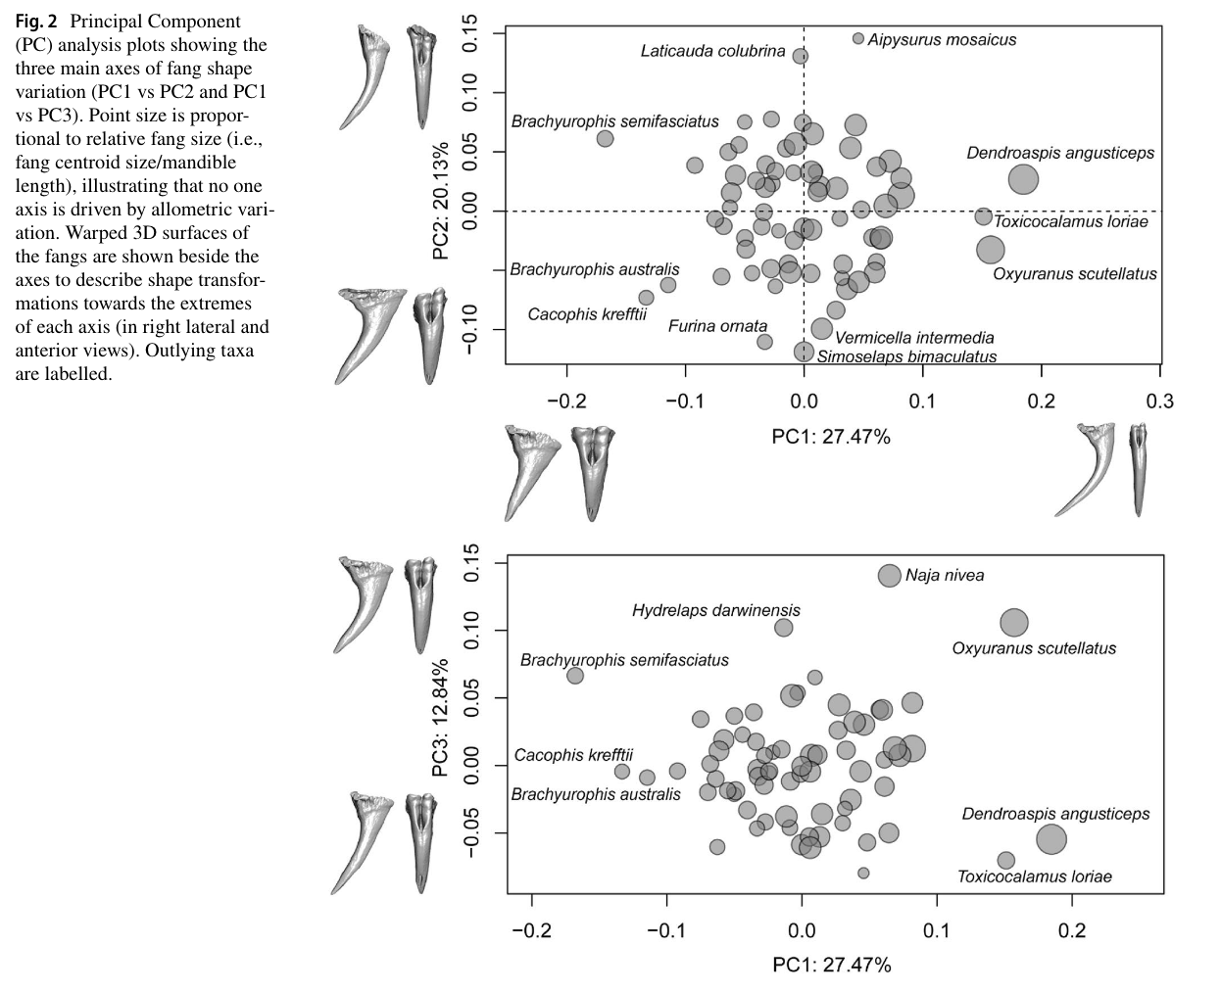
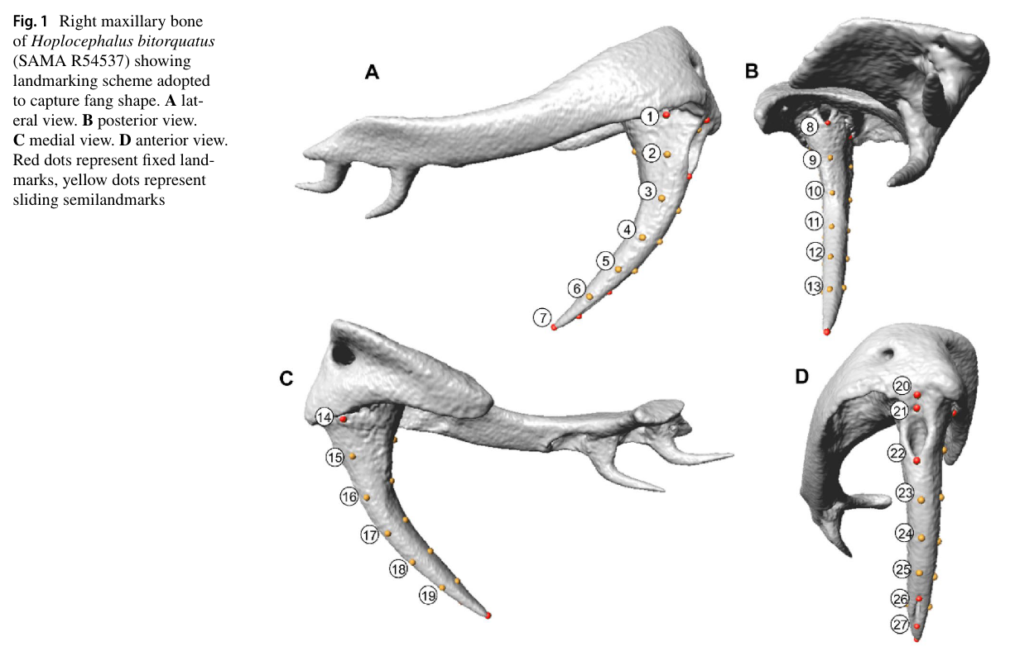

Slide 19
